Slide 1


Pandas library
DATA ANALYTICS BOOTCAMP | IRONHACK

Slide 2


Pandas library
Standard python variables, doesn't include the possibility to load tables of data.
Pandas library was developed to solve this problem. This library includes a new type of object called dataframe or "df" (another convention of the coding community).
Moreover, the Pandas library comes with several methods to deal with this new type of variable.
To use the pandas library use:
import pandas as pd
Pandas library. Why?
00

Slide 3
Pandas library
Pandas API can have changes from version to version.
Therefore, is of the utmost importance to check out which version we have installed in our computer.
Moreover, we need to access the right version of the documentation.
Pandas official documentation
To check out your Pandas library:
pd.__version__
Checking our Pandas version
00

Slide 4
Pandas library
The primary data structures in Pandas are Series and DataFrames
>>> a = pd.Series(np.random.random(10))
>>> print(a)
>>> colnames = ['Column1','Column2','Column3','Column4','Column5']
>>> df = pd.DataFrame(np.random.random((10,5)), columns=colnames)
>>> df.head(5)
Data Structures
00

Slide 5
Pandas library
>>> lst = [208500, 181500, 223500, 140000, 250000, 143000, 307000, 200000, 129900, 118000]
>>> price_df = pd.DataFrame(lst, columns=['SalePrice'])
>>> colnames = ['LotSize','Neighborhood','YearBuilt','Quality','SalePrice']
>>> pd.DataFrame(lst_lst, columns=colnames)
>>> house_dict = { ‘price’: [100000, 250000, 15000], ‘bedrooms’: [1,3,2] }
>>> house_df = pd.DataFrame(house_dict)
Casting data structures to df
00

Slide 6
Pandas library
To retrieve the elements stored in a list, you can simply print the Series.
Series are equivalent to dictionaries, you can obtain particular elements by keys (these keys can be numbers or strings).
Accessing Series elements
00

Slide 7
The column names of a dataframe can be obtained using:
list ( df.columns )
Elements of a dataframe can be accessed in several ways:
Accessing by column name:
df[ [‘Columname’] ]
It returns a dataframe
df[ ‘Columname’ ]
It returns a Series
df[ [‘Col1,’Col2’,’Col3’,’Col4’] ]
With implicit index ( every column has an implicit index like a list, while rows have explicit index )
df.iloc[0:5,:]
With explicit name:
df.loc[:,[‘Col1’,’Col2’,’Col3’]]
Pandas library
Slicing dataframes

Slide 8
Pandas library
# Sum
>>> df[‘Column‘].sum()
>>>np.sum(df[‘Column‘]) ( the same with numpy )
# Mean
>>> df[‘Column‘].mean()
>>>np.mean(df[‘Column‘]) ( the same with numpy )
# Max
>>> df[‘Column‘].max()
>>>np.max(df[‘Column‘]) ( the same with numpy )
Some math functions
00

Slide 9
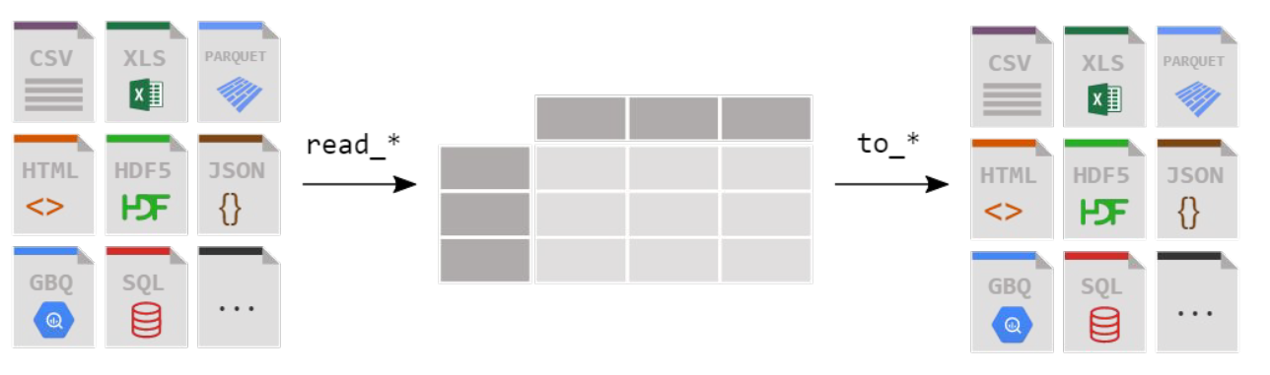
Importing / exporting data:

Slide 10
Pandas library
How we can read a "csv" file?
To this end, Pandas library has the method: read_csv()
pd.read_csv(“file_name”)
If the file is a “txt” you need to provide an the additional keyword: “sep” specifying the field separator
import pandas as pd
import numpy as np
# Reading data
file1 = pd.read_csv('file1.csv')
file1.head()
file2 = pd.read_csv('file2.txt', sep = '\t')
Reading csv files with Pandas
00

Slide 11
Pandas library
We can read Excel files in Pandas!
How we can read Excel files? Using the method: read_excel()
If it doesn’t work type on a “code” cell and try again:
!pip install xlrd
Reading Excel files with Pandas!
00

Slide 12
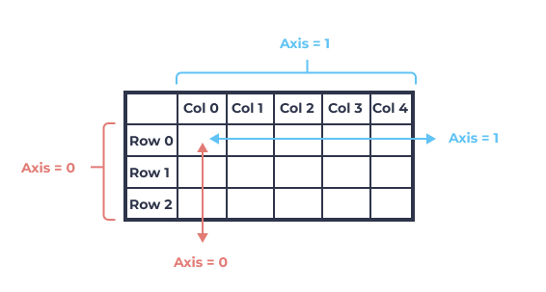
Pandas library
To concatenate the content of two or more files you can use the method: concat()
# Data blending
column_names = file1.columns
data = pd.DataFrame(columns=column_names)
data = pd.concat([data,file1, file2], axis=0)
data.shape
Data blending with Pandas
00

Slide 13
Pandas library
We can know the column names of a dataframe using:
df.columns
To rename the columns you can apply the method: rename() to your dataframe (df).
The rename(columns=dict) method needs a dictionary where:
“keys” are the current column names
“Values” are the new column names
# renaming columns
df = df.rename(columns={ 'controln':'id','hv1':'median_home_val', 'ic1':'median_household_income'})
Dataframe columns
00

Slide 14


